Slide 1
Portfolio
Self - Discription

Slide 2
Topics :
Discription
Page links
What can we do
Technologies used to built

Slide 3
Mir Labib Hossain - Portfolio
Hello this a website of my self portfolio.
This is a onepage website from where others will get to know me better.
And a way to show my skills & works !

Slide 4
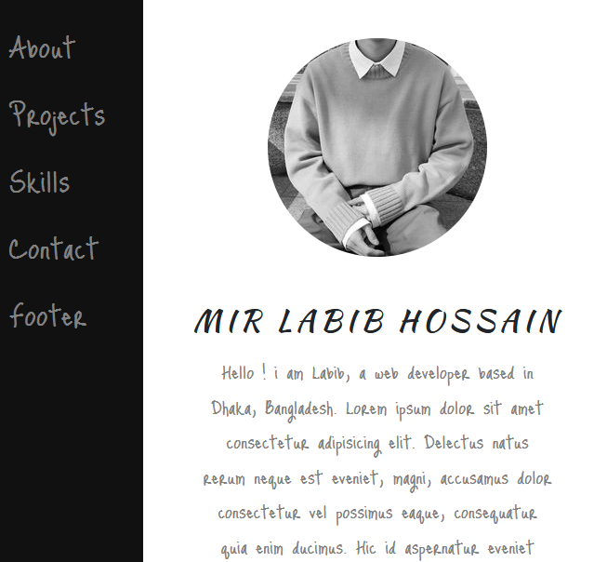
Links
In this website i used few links :
About – Discription about Mir Labib Hossain
Projects – After clicking this every one can see my works and Projects
Skills – The topics i m master in with percentage
Contact – After watching my projects and skill if anyone wanted to contact with me then can click the contact button for contact details includio
Footer – Extra discription

Slide 5
What can an ADMIN & VISITOR can do
Admin can enter into admin panel through username & password and acess into the backend of this website & update / insert / delete any data he wanted.
Visitor can only visit the website and know more about the person whose portflio he is viewing.

Slide 6
Technologies used :
HyperText Markup Language (HTML)
Cascading Style Sheets (CSS)
Bootstrap (B4)
JavaScript

